Slide 1
SkillsUSA Texas 2024 - 2025
Crystal Latham Alford, Executive Director
903-887-4013

Slide 2
State Conference Timeline:
February 25, 2025 | State Registration | Member must be PAID to register
March 19, 2025 | State Registration
March 19, 2025 | Last Day to Cancel Registration or Substitution | Any information in registration that needs to be submitted for an invoice by March 15 will be deleted. Submission must be done before room and registration is guaranteed.
March 19, 2025 | No Refunds | No changes to invoices or hotel reservations
Mar 24-Mar 28, 2025 | Online PD Test Window Opens | The link will be sent to the student’s registration email address on the evening of March 24, 2025.
April 22, 2025 | All payments due | If received after the payment deadline, a $50 monthly fee will be assessed. Please add a 3% processing fee if paying with a credit card. “S” invoices will be due to PO Box 65087 Lubbock, TX 79464.
April 5, 2025 | National Packet Release
April 12, 2025 | Final Review and Scoring Uploads

Slide 3
Membership - Registration
Membership must be paid in order to register. If you need help with membership contact customer care: 844-875-4557.
Registration Reminder
Registration and Substitutions for state close on
March 19th at 11:59pm.
NO LATE REGISTRATION.
M Invoice - National Office
S Invoice - State Office

Slide 4
State Conference: Testing
Online Testing window is Monday, March 24 - Friday, March 28th 11pm.
The emails to registered advisors with the login information for their campus will go out on Monday, March 24th.
Please plan and have your students prepared.
REMINDERS:
Resumes (1 page) will be turned in person at State (Must have a resume for each contest.)
NOCTI Testing Instructions (Website & March Newsletter)
Register students with non school email. Check shirt sizes and emails for all students. Changes can be made till the 15th.
No make-up dates
Professional Development Test Score Counts (Study Guide Online)
Assessment Test Score will be done prior to contest. Scores will count.
Test should be teacher/advisor proctored.

Slide 5
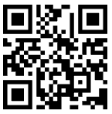
Job Exhibits - Reg and Interviews
Job Exhibit interviews will take place during a designated four-hour window each day per cluster, allowing contestants to complete their interview at a scheduled time.
During the interview, contestants will participate in an Oral Defense to discuss their project with a judge. This includes answering three key questions related to the execution and process of their work.
Important Guidelines:
• Attendance Requirement: Contestants must be present for their interview; failure to attend will result in ineligibility for the Best of Show award. They will still be able to obtain a score that will allow them to be in the running for a blue ribbon. The interview is just the advancement portion for Best of Show.
• Attire: Contestants must wear a white polo and black slacks or the designated contest attire outlined in the SkillsUSA National Standards for their career path (e.g., nursing contestants should wear blue scrubs).
This interview process allows contestants to showcase their skills, knowledge, and craftsmanship while demonstrating their understanding of their exhibit.
The scoring rubric if the student is not completing an interview is as follows:
Superior 310-350
Excellent 270-309
Very Good 230-269
N/A 0-229

Slide 6
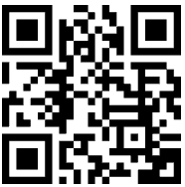
State Registration Packet Pick-up
Two Options
QR Code
Two lines will be provided in the Registration area. One for those pre-registered with a time and those that did not.
Pre-register deadline is
March 25

Slide 7
Live Entertainment - Thursday Night
We’re excited to announce that the SkillsUSA Texas Champions Festival will feature country music artist Corey Kent!
Who Can Attend? Only registered attendees will have access to this exclusive event. Any outside guests must pay a $50 fee by Wednesday before the event to attend.
Entry Requirements: Green wristbands, included in your registration packet, will be required for concert entry.
Dress Code: School dress code will be enforced—please ensure compliance.
Schedule:
Doors Open: 5:30 PM
Opening Act: 6:30 PM
Corey Kent Performance: 7:00 PM

Slide 8
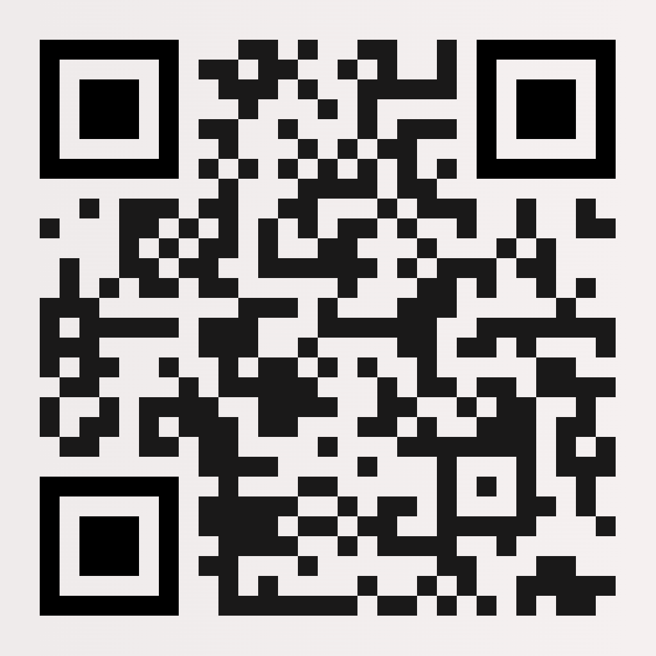
Observers - Parents
QR Code
ALL ATTENDEES MUST HAVE VERIFICATION TO BE IN THE BUILDING.
Any one under the age of 10 year old, must have a wristband and pay an observer badge fee of $50. All attendees wanting to attend the concert on Thursday must pay full registration ($100).
SkillsUSA Texas is a cashless vendor and all payment for event can be made through the observer portal with a credit card or debit card, or onsite with Venmo. No Cash will be taken onsite!
Notes:
https://eform.pandadoc.com/?eform=4ef5b49e-37b2-48d4-8018-d1eceb631eb2

Slide 9
Conference App - Yapp (March 15)
We are beyond excited to be offering a more user-friendly app for this year’s State Leadership & Skills Conference!
We are using a fantastic platform called Yapp to host our SLSCTX25 App so you’ll need to download that app first and foremost.
﻿We will be adding updates to the app throughout the conference. There are several events and prize opportunities throughout the conference, and we will post updates on the app. Don't miss out!
Notes:
https://docs.google.com/document/d/1xqIXmdXzWsQhYU7dgc5rQRy4D0ACi9ShxPMJdlv_alo/edit?tab=t.0#heading=h.aifvrermnbmo

Slide 10
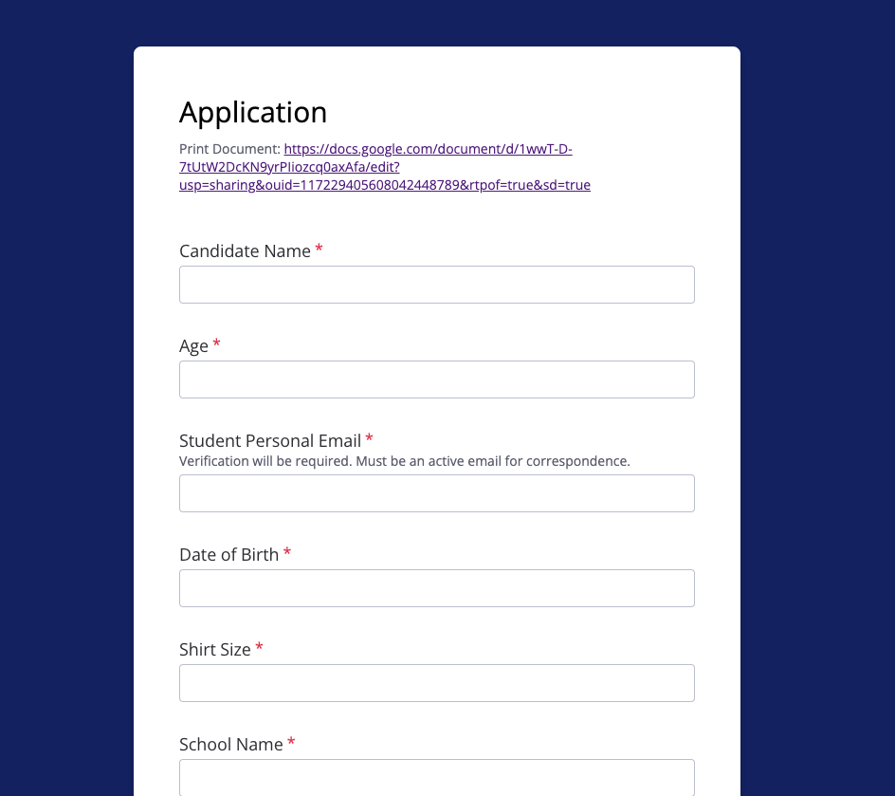
State Officer Application - Deadline 3/15
March 19 - Notified for Testing
March 24 - Testing
March 25 - Top 30
April 2 - Interviews, Top 15 Announced at Opening
April 4 - Speeches & Questions
April 5 - Announcement of Officers at Closing

Slide 11
Delegate Session - Friday, April 3 @4pm
Wristbands will be given in registration packets.

Slide 12
Summer Leadership
Save the Date: May 31-June 6, 2025
Training is available for SkillsUSA Texas District Officers plus three alternates and their Advisors.
Registration opens April 10th and closes May 10th. Payment is due June 10th. No cancelation or refund after May 10th.
Registration includes: Training materials, Conference shirt for 4 days, 11 meals and refreshments. Cost for 2025 is $700 plus lodging.
Hotel reservations will be made via rooming list from the State Office, do not book directly with Mo Ranch.
State officers and National officer candidates arrive May 31st no later than 3pm
All other participant registration pickup onsite Mon June 2nd at 1pm
Location is Mo Ranch 2229 FM 1340, Hunt, TX 78024

Slide 13
State Hotels:
2025 State Reminders
Opening Ceremonies on Wednesday at 7:30p Arena
Closing Ceremonies on Saturday at 9am Arena
No Orientations will began before 3:00pm on Wednesday, except Teamworks and Carpentry.
Review schedule - Some competitions have been moved to Convention Center.
Concert on Thursday in arena and no activity on Friday
Contest Schedule is on Website with Updates link.
All hotel blocks open December 15.
A link to the hotel booking options will be on the website along with hotel amenities.
Hotels are to be fully booked by the school.
Cancelation dates and terms are with the hotel, please read carefully.
Notes:
https://skillsusatx.org/events/state-leadership-and-skills-conference/

Slide 14
SkillsUSA Texas Board Elections
Board of Directors:
3 Open Positions
(3-year term)
Application process opens on
Friday, March 7th.
Candidates announced on
March 24th.
Online Voting will take place Tuesday April 1st.
Applications link will be posted on the website.
Your Texas Board of Directors Chair is David Lanman.
Eligibility Regions:
Region 1: 1,2,3,4
Region 2: 5,6,7,8
Region 3: 9,10,11,12,13

Slide 15
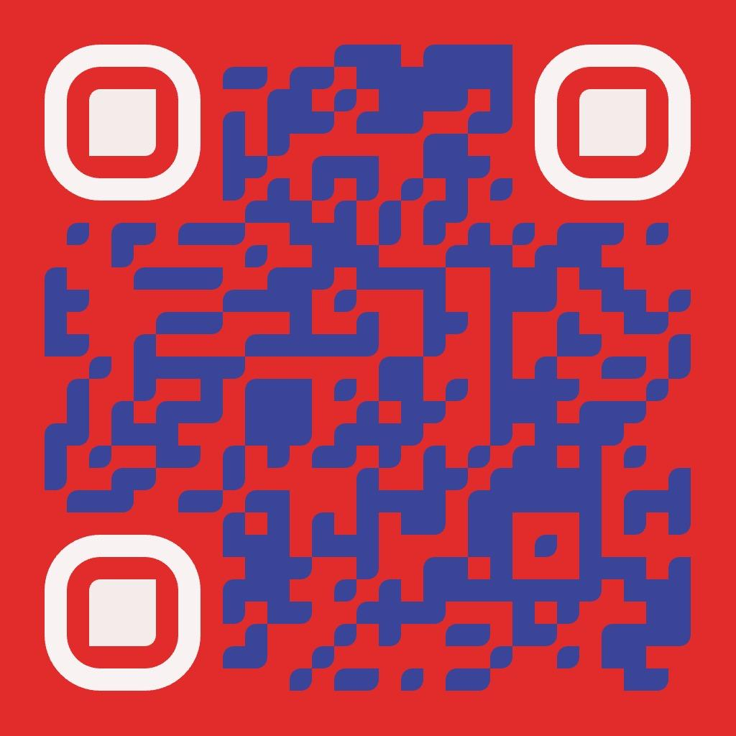
State Volunteers and Judges
Interested in helping at state or have a industry partner or alumni wanted to lend a hand. Complete this form to get more information.
You will receive an email from techchair@skillsusatx.org
Chris are excited to get you registered.

Slide 16
Next Town Hall, Thurs April 24th at 5:30pm

